Slide 1
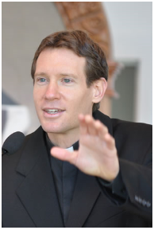
Little Flower Men’s Night
October 8, 2016
Discerning with the Spirit
Fr. Michael Gaitley
Ordained to priesthood October 16, 2010.
Holds Masters in Theology from St. John Seminary in MA and Licentiate Degree in Spiritual Theology from the Dominican House of Studies, Washington, D.C.
Director of the Association of Marian Helpers, a spiritual benefits society of the Congregation of Marian Fathers of the Immaculate Conception
Author of several best sellers, including 33 Days to Morning Glory and Consoling the Heart of Jesus: A Do-it-Yourself Retreat Inspired by the Spiritual Exercises of St. Ignatius, now in second printing and becoming a modern classic
When not preaching missions and retreats, lives and works in Stockbridge, MA, home of the National Shrine of The Divine Mercy

Slide 2
Little Flower Men’s Night
Opening Song
My Victory
Crowder

Slide 3
Little Flower Men’s Night
Opening Prayer
Introductions

Slide 4
Little Flower Men’s Night
Discerning with the Spirit
Fr. Michael Gaitley
2015
Franciscan University of Steubenville

Slide 5
Little Flower Men’s Night
Reflection . . .
Now is the time of mercy. Where sin/evil abounds, grace abounds all the more!
“The blood of the martyrs is the seed of the Church” – Tertulian (Father of the Early Church)
The meaning of life is to become a saint. Total consecration to Jesus through Mary: quickest, easiest way to sainthood
“My grace is enough for you” (2 Cor 12:9)
Jesus didn’t come for the righteous, He came for sinners.
“The greater the sinner, the greater his right to my mercy” --- message from Jesus to Saint Faustina
God doesn’t love us because of how good we are, but because of how good He is.
God’s love and mercy is always waiting for us.

Slide 6
Other opportunities to
deepen our faith . . .

Slide 7
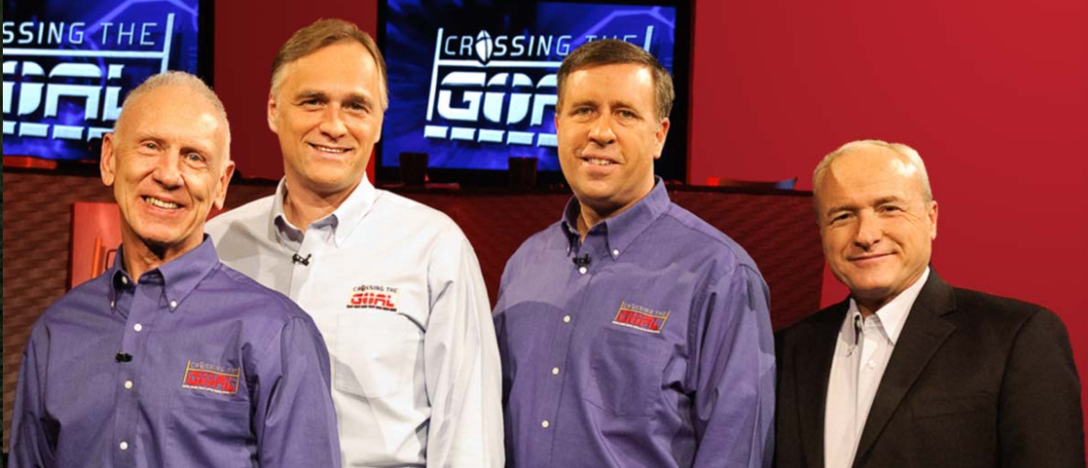
EWTN . . .
Crossing The Goal
Friday 5:30-6:00 pm
http://www.crossingthegoal.com

Slide 8
Upcoming . . .
A.C.T.S. Retreat for Men
Adoration Community Theology Service
Thursday – Sunday
November 3-6, 2016

Slide 9
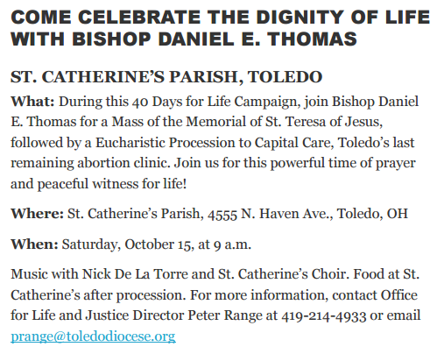
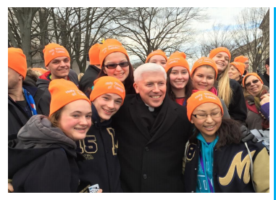
Upcoming . . .
40 Days For Life Campaign
Saturday, October 15 - 9am
http://toledodiocese.org/events/detail/4486/diocesan

Slide 10
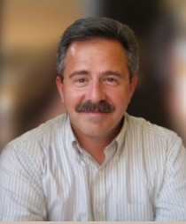
Next Men’s Night
Saturday, November 12
7-9 pm
Why Be Catholic?
Patrick Madrid
St. Francis Room
Bring a friend!

