Slide 1
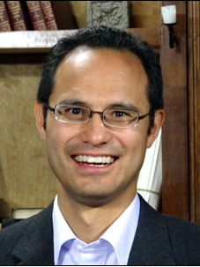
Little Flower Men’s Night
September 10, 2016
The Virtues of the Christian Disciple
Dr. Edward Sri
Theologian, author and well known Catholic speaker, appearing regularly on EWTN.
Currently: Professor of Theology and Vice President of Mission and Outreach at the Augustine Institute in Denver
Founding leader with Curtis Martin of FOCUS (Fellowship of Catholic University Students).
Content director and host of acclaimed Catholic video series called Symbolon (Augustine Institute).
Leads pilgrimages to Rome and Holy Land
Education: Doctorate form the Pontifical University of St. Thomas Aquinas in Rome.
Resides with his wife and seven children in Littleton, CO

Slide 2
Little Flower Men’s Night
Opening Song
Hello My Name Is
Matthew West

Slide 3
Little Flower Men’s Night
Opening Prayer
Introductions

Slide 4
Little Flower Men’s Night
The Virtues of the Christian Disciple
Dr. Edward Sri
July 26, 2012
Franciscan University of Steubenville

Slide 5
Little Flower Men’s Night
Reflection . . . St. Paul’s Letter to Ephesians (Ch. 4)
“Lead a life worthy of the calling to which you have been called”
Virtue: habitual disposition to do the good (Catechism) with ease, promptly, consistently and with love
Do I live the virtues of Christ each day? They affect both us and others in our life.
Virtue vs. Values --- Virtue helps put values into practice
Humility: total dependency on God.
Vanity: vice that undermines humility. Seeks glory of this world, recognition, honor
Patience: Moderates our sorrow. Persist firmly. Allows us to keep loving others when they hurt us.
Anger: Ok, if motivated by love--what’s best for others.
Meekness: Moderates the passion of anger
Do we use speech to build up -- or to tear down?

Slide 6
Other opportunities to
deepen our faith . . .

Slide 7
Men’s Bible Study
Saturday Mornings
7:30 - 8:30 am
Little Flower Parish House
Little Flower Daily Mass
Monday – Thursday 8:15am
Tuesday 7:00 am
Adoration
Every Wednesday -- 9am – 7pm
(All day starting September.
No First Friday mass and adoration)

Slide 8
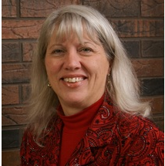
Catholic Radio . . .
89.7 FM
Monday 4-5pm, Saturday 8pm

Slide 9
Upcoming . . .
A.C.T.S. Retreat for Men
Adoration Community Theology Service
Thursday – Sunday
November 3-6, 2016

Slide 10
Upcoming . . .
COMMITTED Adult Education
Sundays 9:45 to 10:45am - St. Francis Room Same Sundays as FOUNDATIONS
Follows Symbolon videos on formed.org
Last year: discussed how not to let the world present a ‘nerfy’ picture of Jesus…
Come every week or any week

Slide 11
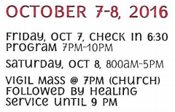
Upcoming . . .
http://www.mccrholyspirit.org

Slide 12
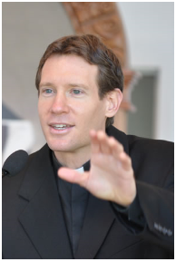
Next Men’s Night
Saturday, October 8
7-9 pm
Discerning with the Spirit
Fr. Michael Gaitley
St. Francis Room
Bring a friend!

