Slide 1
Welcome to
Little Flower Men’s Night
Saturday, October 3
Hope in the Love of Jesus
With Father Klem Hasencox

Slide 2
Little Flower Men’s Night
Opening Song
Hold Us Together
Matt Maher

Slide 3
Opening Song
Opening Prayer
Introductions

Slide 4
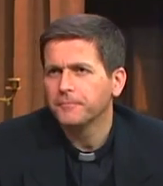
Fr. Klem Hasencox
Member of the Apostolate for Family Consecration -- a Catholic lay movement sanctioned by the Church with focus on families as evangelizers of our faith
Serves at Catholic Family Land in Steubenville, Ohio

Slide 5
Little Flower Men’s Night
Hope in the Love of Jesus
Father Klem Hasencox
Apostolate for Family Consecration

Slide 6
“Patience is the companion of wisdom.”
-- Saint Augustine

Slide 7
Other opportunities to
deepen our faith . . .

Slide 8
Upcoming . . .
A.C.T.S. Retreat for Men
Adoration Community Theology Service
Thursday – Sunday
November 19-22, 2015

Slide 9
Upcoming . . .
Lift Jesus Higher Rally
ljhrtoledo.com

Slide 10
Next Men’s Night
Saturday, December 5
7-9 pm
Speaker and Topic TBA
Little Flower Parish House
Bring a friend!

