Slide 1
Welcome to
Little Flower Men’s Night
Saturday, August 23
Priest, Prophet and King
With Father Robert Barron

Slide 2
Opening Prayer
Introductions
Name
Parish (if not Little Flower)

Slide 3
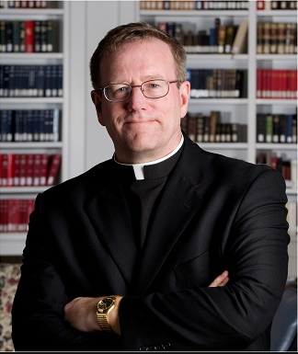
Father Robert Barron
Ordained in 1986, a priest of the Archdiocese of Chicago. Author, speaker and theologian
Founder of the global media ministry Word on Fire, utilizing new media to draw people into and back to the Catholic faith
Currently: Rector/President of Mundelein Seminary University of St. Mary on the Lake
Host of Catholicism, a groundbreaking, award winning documentary series about the Catholic faith
Education: Masters in Philosophy from Catholic University of America (1982), Doctorate in Sacred Theology from Institut Catholique de Paris (1992)
On-air contributor/analyst /commentator for NBC News, Chicago Tribune, FOX News, CNN, EWTN, Our Sunday Visitor and other media outlets
Published numerous books, essays, DVD programs
Lectured extensively in the US and abroad, including universities at the Vatican and in Rome

Slide 4
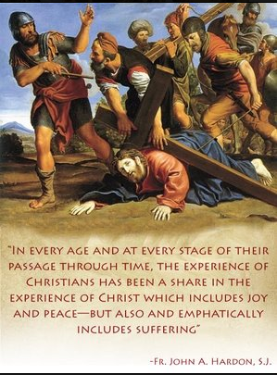
Priest, Prophet and King
With Father Robert Barron

Slide 5
Priest, Prophet and King
With Father Robert Barron
YouTube Link:
Father Robert Barron - Priest, Prophet and King

Slide 6
Father Robert Barron
Ordained in 1986, a priest of the Archdiocese of Chicago. Author, speaker and theologian
Founder of the global media ministry Word on Fire, utilizing new media to draw people into and back to the Catholic faith
Currently: Rector/President of Mundelein Seminary University of St. Mary on the Lake
Host of Catholicism, a groundbreaking, award winning documentary series about the Catholic faith
Education: Masters in Philosophy from Catholic University of America (1982), Doctorate in Sacred Theology from Institut Catholique de Paris (1992)
On-air contributor/analyst /commentator for NBC News, Chicago Tribune, FOX News, CNN, EWTN, Our Sunday Visitor and other media outlets
Published numerous books, essays, DVD programs
Lectured extensively in the US and abroad, including universities at the Vatican and in Rome

Slide 7
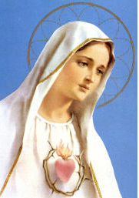
August
Immaculate Heart of Mary
“To save poor sinners, God wishes to establish in the world devotion to my Immaculate Heart.”
-- Mary to the children in the visions of Fatima, July 13, 1917

Slide 8
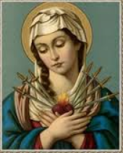
September
Seven Sorrows of Mary
Feast of Our Lady of Sorrows (Sept. 15)
"The purest suffering bears and carries in its train the purest understanding.”
--St. John of the Cross

Slide 9
Other opportunities to
deepen our faith . . .

Slide 10
Men’s Bible Study
Saturday Mornings
7:30 - 8:30 am
Little Flower Parish House

Slide 11
Adoration
Every Wednesday -- 6-7 pm
First Friday of the Month -- 8:45am – 8pm
Little Flower Church

Slide 12
A.C.T.S. Retreat
Adoration Community Theology Service
Thursday – Sunday
November 20-23, 2014

Slide 13
Annunciation Radio WNOC 89.7 FM EWTN Television Learn more about your faith!
Catholic Media in Toledo

Slide 14
Annunciation Radio WNOC 89.7 FM Kresta in the Afternoon Hosted by Al Kresta Talk radio program. Looks at all areas of life through the lens of Scripture and the teaching of the Catholic Church. Monday-Friday 4-6 pm
Catholic Radio in Toledo

Slide 15
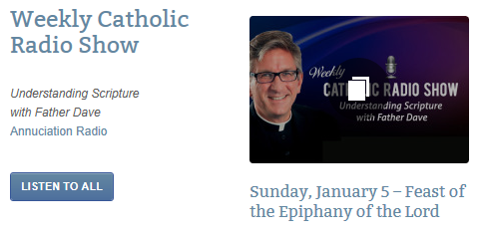
Annunciation Radio WNOC 89.7 FM Understanding Scripture with Father Dave Father Dave Nuss
Catholic Radio in Toledo
Sun. 8:00 am
Wed. 8:00 pm
Fri. 8:30 am
Sat. 11:00 am
Available on Little Flower Parish website

Slide 16
Be a Man With Father Larry Richards Fr. Larry reminds men that true strength comes from God and not by themselves, and it is through surrendering to Him in their daily lives that they become strong. Monday-Friday 6:30-7:00 pm
EWTN Television

Slide 17
Next Men’s Night
Saturday, September 6
7:00 PM to 9:00 PM
Crossing the Goal
Episode: Jesus Said “Wake Up!”
Little Flower Parish House
Bring a friend!

