Slide 1
Welcome to
Little Flower Men’s Night
Saturday, May 3
Really Knowing Jesus with
Father John Riccardo

Slide 2
Opening Prayer
Introductions
Name
Parish (if not Little Flower)

Slide 3
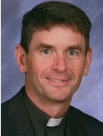
Father John Riccardo
Priest in the Archdiocese of Detroit, ordained in 1996
Graduate of University of Michigan
Studied at Sacred Heart Major Seminary (Detroit) Gregorian University (Rome)
Received Sacred License in Theology (S. T. L.) from Pope John Paul II Institute for Studies on Marriage and the Family
Current: Pastor at Our Lady of Good Counsel in Plymouth, Michigan
Previous service at parishes in Troy and Dearborn
Former Director of Cardinal Maida Institute at St. John Center for Youth and Family in Plymouth, Michigan
Hosts Catholic Radio program Christ is the Answer, focusing on catechetical teachings
Expert on John Paul II’s Theology of the Body
Popular speaker and teacher at pro life and faith-based events

Slide 4
“The problem is not that the truth is unknown; the problem is the truth is unlived.”
-- Dr. John Wood
Author of Ordinary Lives Extraordinary Mission

Slide 5
Father John Riccardo
Priest in the Archdiocese of Detroit, ordained in 1996
Graduate of University of Michigan
Studied at Sacred Heart Major Seminary (Detroit) Gregorian University (Rome)
Received Sacred License in Theology (S. T. L.) from Pope John Paul II Institute for Studies on Marriage and the Family
Current: Pastor at Our Lady of Good Counsel in Plymouth, Michigan
Previous service at parishes in Troy and Dearborn
Former Director of Cardinal Maida Institute at St. John Center for Youth and Family in Plymouth, Michigan
Hosts Catholic Radio program Christ is the Answer, focusing on catechetical teachings
Expert on John Paul II’s Theology of the Body
Popular speaker and teacher at pro life and faith-based events

Slide 6
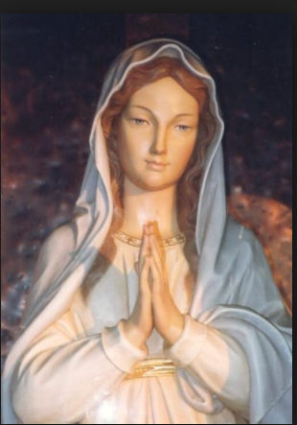
May is the month of Mary . . .
"Give me an army saying the Rosary and I will conquer the world."
--Saint Pope Pius IX

Slide 7
Other opportunities to
strengthen your faith . . .

Slide 8
Men’s Bible Study
Saturday Mornings 7:30 to 8:30 AM
Little Flower Parish House

Slide 9
Men’s Koinonia Group
Koinonia (from the Greek):
communion, joint participation, fellowship.
Tuesday and Wednesday Evenings
(Through June)
7:00 – 8:00 pm
St. Francis Room

Slide 10
Annunciation Radio WNOC 89.7 FM Learn more about your faith!
Catholic Radio in Toledo

Slide 11
Annunciation Radio WNOC 89.7 FM Christ is the Answer Father John Riccardo Sunday 9-10am Mon – Thurs 2-3pm Also online (Google)
Catholic Radio in Toledo

Slide 12
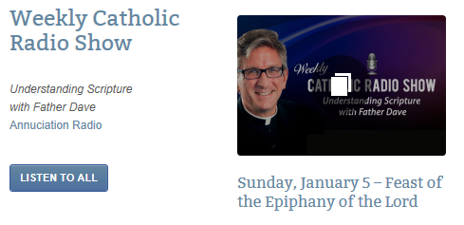
Annunciation Radio WNOC 89.7 FM Understanding Scripture with Father Dave Father Dave Nuss
Catholic Radio in Toledo
Sun. 8:00 am
Wed. 8:00 pm
Fri. 8:30 am
Sat. 11:00 am
Now available on Little Flower Parish website

Slide 13
Next Men’s Night
Saturday, June 14
7:00 PM to 9:00 PM
The Bible and the Sacrifice of the Mass
with Dr. Scott Hahn
Little Flower Parish House
Bring a friend!

