Slide 1
Welcome to
Little Flower Men’s Night
Saturday, January 18th
To Know Jesus Christ with
Fr. Jonathan Morris

Slide 2
Opening Prayer
Introductions
Name
Parish (if not Little Flower)

Slide 3
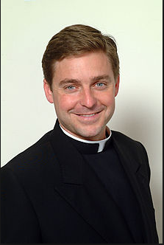
Father Jonathan Morris
Archdiocese of New York, special assistant to Cardinal Timothy Dolan for media communications
Native of Cleveland, Ohio
Education
Business Administration – Franciscan University, Steubenville, OH
Seminary at age 21
2004 Magna Cum Laude, Licentiate graduate degree in Moral Theology
Mass Media
Theological advisor on movie sets
News analyst, Fox News, Fox Business Channel
Contributor, Wall Street Journal
Author of two books (2008, 2011)
Program Director, The Catholic Channel (Serius XM Satellite Radio)

Slide 4
“What does love look like? It has the hands to help others. It has the feet to hasten to the poor and needy. It has eyes to see misery and want. It has the ears to hear the sighs and sorrows of men. That is what love looks like.”
- Saint Augustine

Slide 5
Father Jonathan Morris
Archdiocese of New York, special assistant to Cardinal Timothy Dolan for media communications
Mass Media
Theological advisor on set of The Passion of the Christ
Contributor to CNN coverage of Pope John Paul II’s death and election of Pope Benedict XVI
News analyst from ethical, social and faith perspective for Fox News Channel, Fox Business Channel
Contributor, Wall Street Journal
Author
The Promise: God’s Purpose and Plan for When Life Hurts (2008)
God Wants You Happy: From Self-Help to God’s Help (2011)
Program Director, The Catholic Channel (Serius XM Satellite Radio)

Slide 6
How can we love as Jesus loves?

Slide 7
“Not all of us can do great things. But we can do small things with great love.”
- Mother Teresa

Slide 8
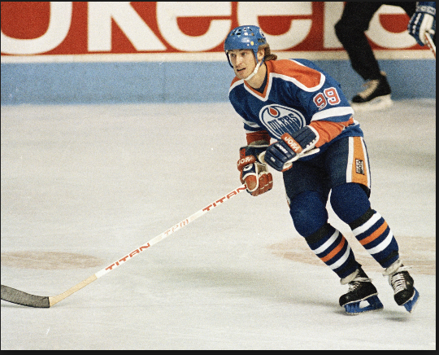
“You miss 100% of the shots you don’t take.”
- Wayne Gretzky

Slide 9
Men’s Bible Study
Saturday Mornings 7:30 to 8:30 AM
Little Flower Parish House

Slide 10
Next Men’s Night
Saturday, February 15, 2014
7:00 PM to 9:00 PM
Now is the Time with
Sister Ann Shields, S.G.L.
Little Flower Parish House
Invite a friend!

Slide 11
Pray for End to Abortion
www.usccb.org
Novena prayers available via app, text message, email, printed copy

Slide 12
Saturday, March 15th Seagate Center
Toledo Catholic Men’s Conference

Slide 13
A.C.T.S. Retreat
Adoration Community Theology Service
Thursday – Sunday
March 20-23

Slide 14
Next Men’s Night
Saturday, February 15, 2014
7:00 PM to 9:00 PM
Now is the Time with
Sister Ann Shields, S.G.L.
Little Flower Parish House
Invite a friend!

