Slide 1
Welcome to
Little Flower Men’s Night
Saturday, November 9th
Transformation with Danny Abramowicz

Slide 2
Opening Prayer
Introductions
Name
Parish

Slide 3
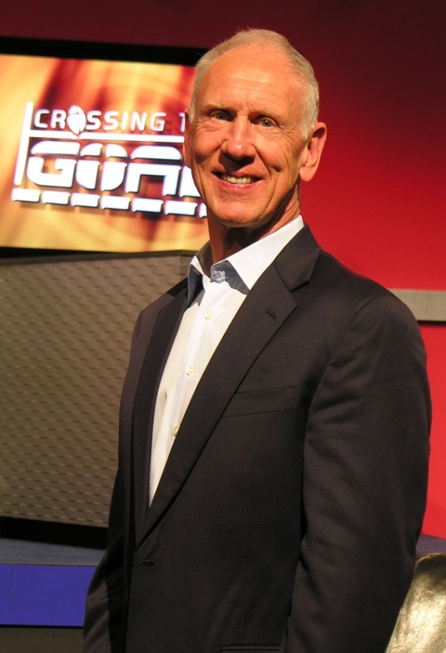
Danny Abramowicz is presently involved with Crossing the Goal Ministries, which is an evangelization outreach to Catholic men. This ministry utilizes TV, internet, conferences and leadership seminars to accomplish its goal. Danny was also a famed NFL player, coach and broadcaster. Danny was born July 13, 1945, in Steubenville, Ohio. He attended Xavier University in Cincinnati, Ohio, and was presented with the two most prestigious awards bestowed on a student athlete - Legion of Honor and Hall of Fame. In 1967, Danny was drafted in the 17th and last round by the New Orleans Saints. His accomplishments include the NFL's leading receiver and All-Pro in 1969. Currently, Danny serves on the EWTN Board of Directors and in an advisory capacity to the Board of Directors of National Fellowship of Catholic Men. Danny and his wife, Claudia, have been married for 43 years and have three children and four grandsons.

Slide 4
EWTN TV
Crossing The Goal
Sunday 6:30 P.M.
Monday 6:30 A.M.
Thursday 9:00 P.M.
Friday 10:00 P.M.

Slide 5
- St. Augustine
“Pray as though everything depended on God. Work as though everything depended on you."

Slide 6
Danny Abramowicz is presently involved with Crossing the Goal Ministries, which is an evangelization outreach to Catholic men. This ministry utilizes TV, internet, conferences and leadership seminars to accomplish its goal. Danny was also a famed NFL player, coach and broadcaster. Danny was born July 13, 1945, in Steubenville, Ohio. He attended Xavier University in Cincinnati, Ohio, and was presented with the two most prestigious awards bestowed on a student athlete - Legion of Honor and Hall of Fame. In 1967, Danny was drafted in the 17th and last round by the New Orleans Saints. His accomplishments include the NFL's leading receiver and All-Pro in 1969. Currently, Danny serves on the EWTN Board of Directors and in an advisory capacity to the Board of Directors of National Fellowship of Catholic Men. Danny and his wife, Claudia, have been married for 43 years and have three children and four grandsons.

Slide 7
Annunciation Radio WNOC 89.7 FM
Understanding Scripture
with Father Dave
Sunday 1:30 PM
Wednesday 8:00 PM
Thursday 2:00 PM
Friday 8:30 AM
Saturday 11:00 AM

Slide 8
Annunciation Radio WNOC 89.7 FM
Father John Riccardo
Sunday 8:30 AM
Monday 8:00 PM
Wednesday 2:00 PM
Saturday 1:30 PM

Slide 9
Men’s Bible Study
Saturday Mornings 7:30 to 8:30 AM
Little Flower Parish House

Slide 10
Upcoming Men’s Nights
Saturday December 7th
Evangelization with Curtis Martin
7:00 - 9:00 PM
Little Flower Parish House

